Slide 1
BUILDING SUSTAINABLE ELECTRICITY TOGETHER – POWER OF COMMUNITY

Slide 2
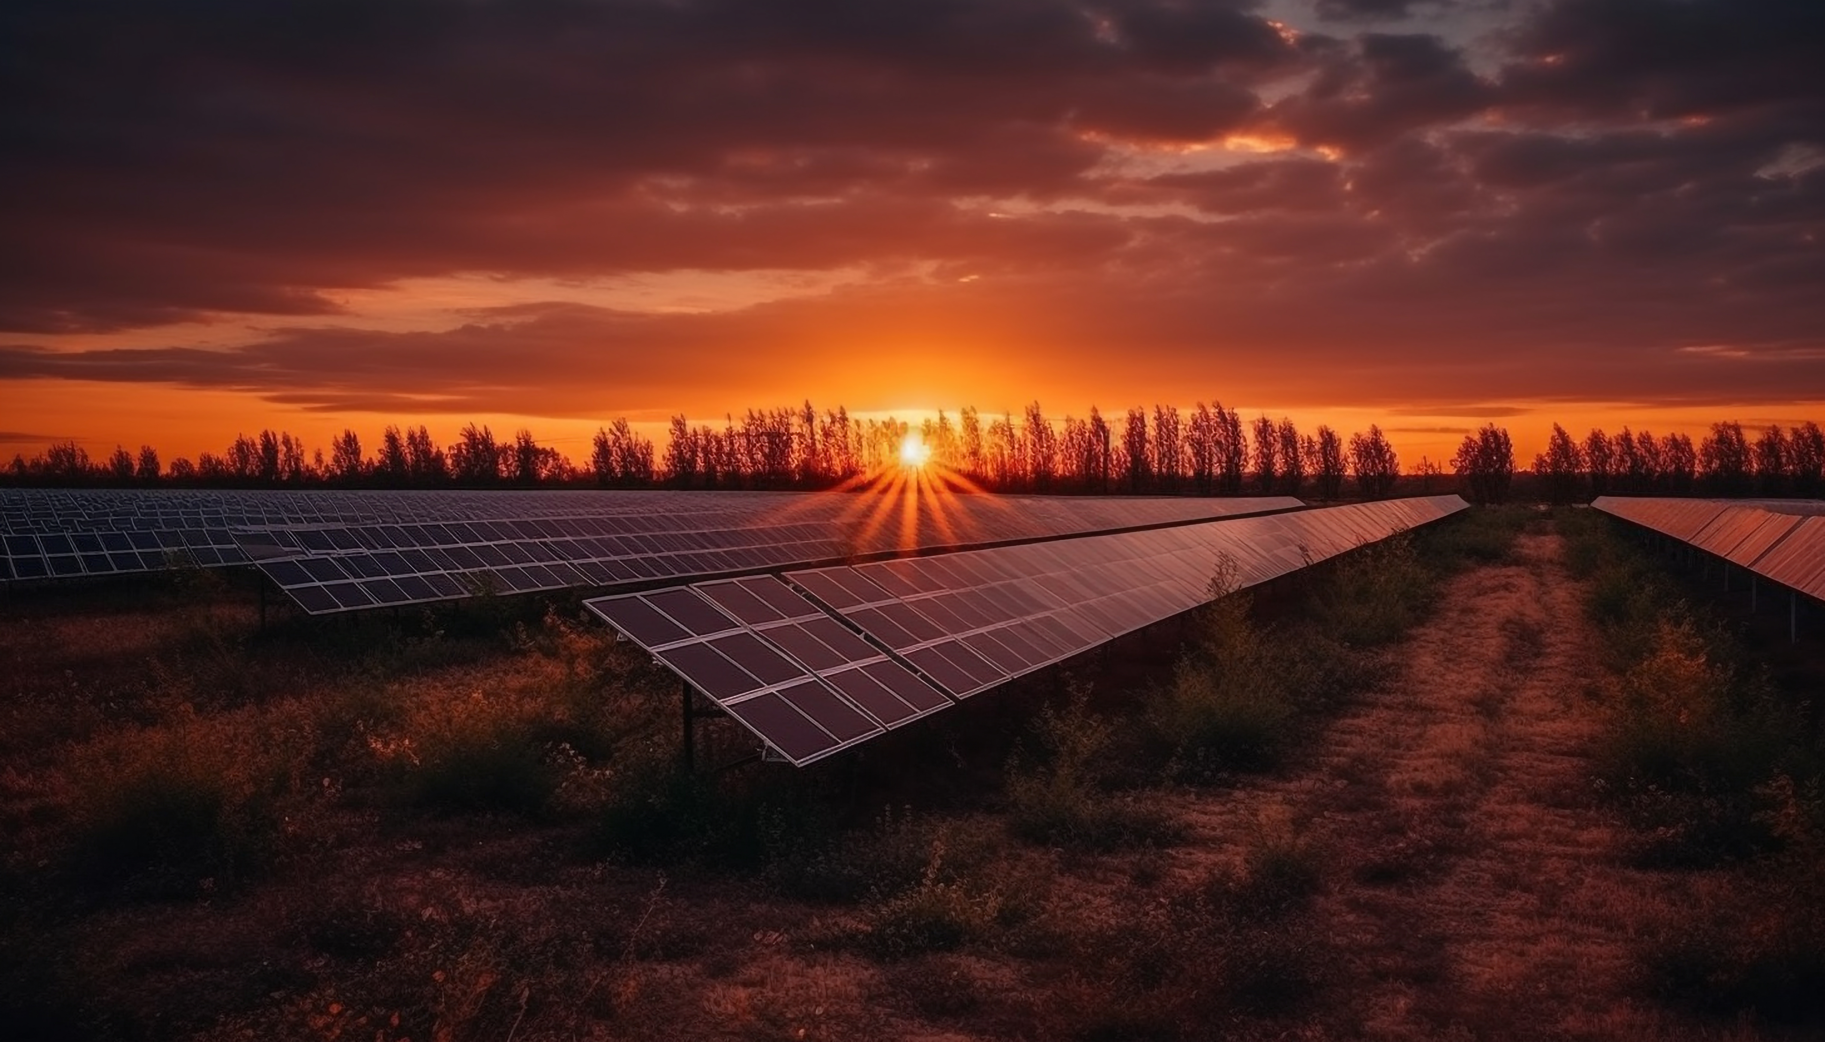
BUILDING SUSTAINABLE ELECTRICITY TOGETHER – POWER OF COMMUNITY

Slide 3
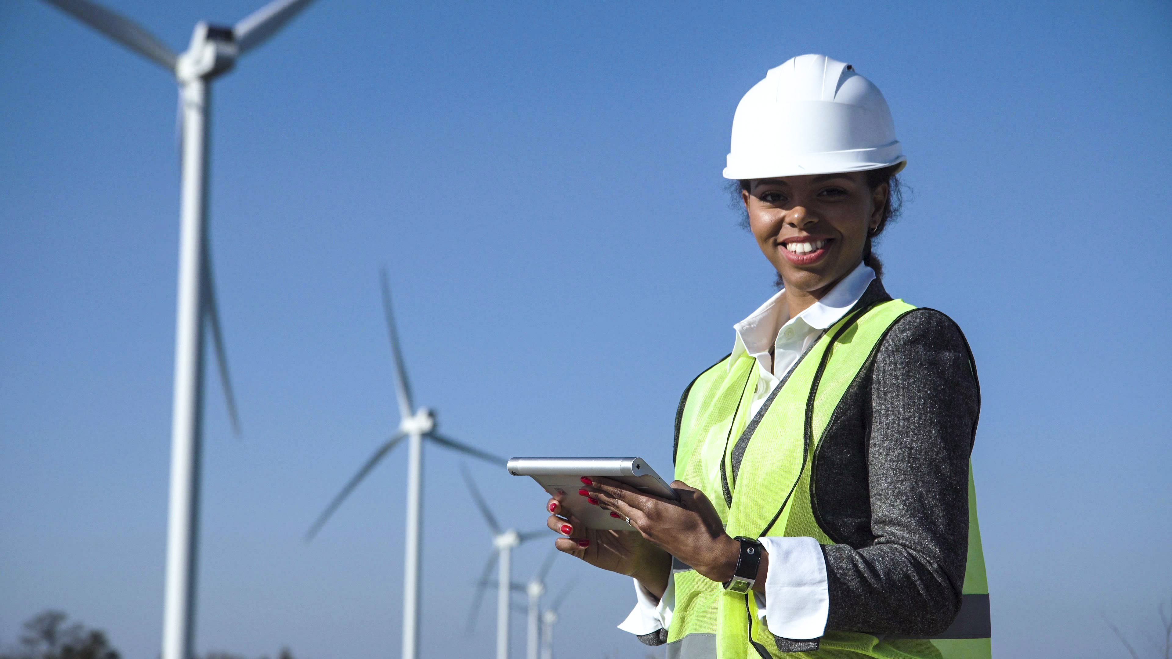
BUILDING SUSTAINABLE ELECTRICITY TOGETHER – POWER OF COMMUNITY

